Slide 1

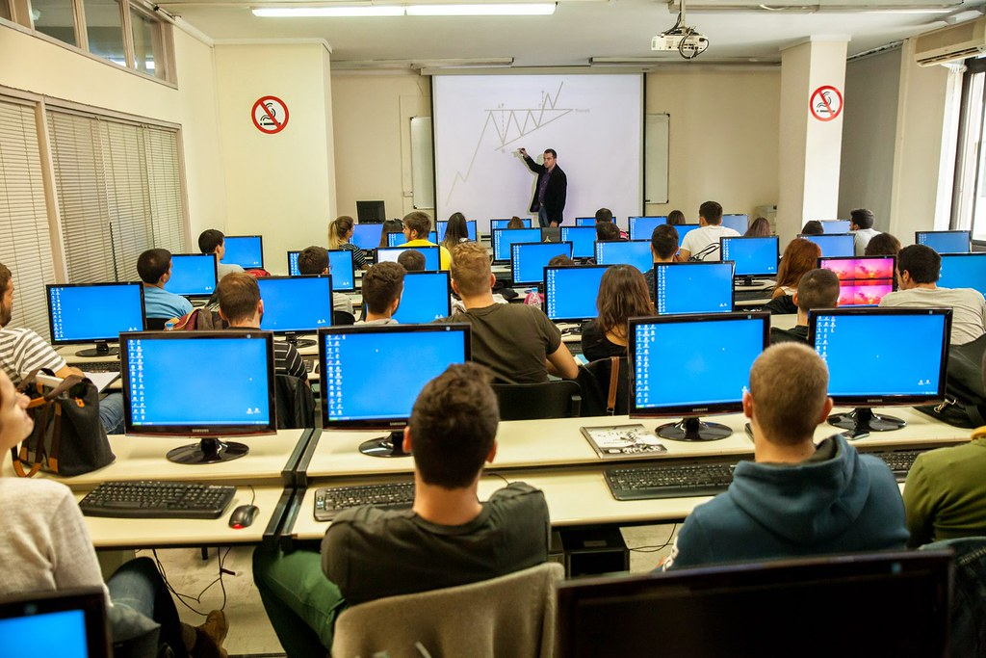
WELCOME TO THE PRESENTAION
9.24.XX
Annual Review
This Photo by Unknown Author is licensed under CC BY

Slide 2
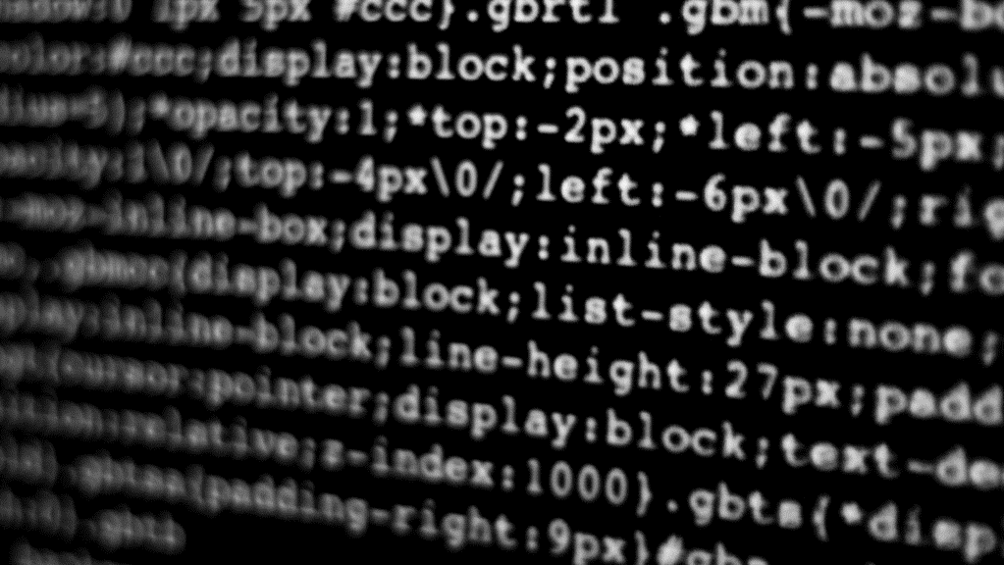
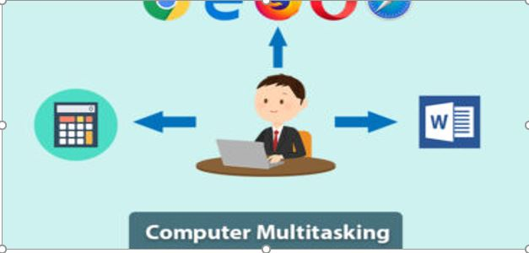
A SATISFIED CUTOMER
Topic: Computer Multitasking
This Photo by Unknown Author is licensed under CC BY-SA

Slide 3
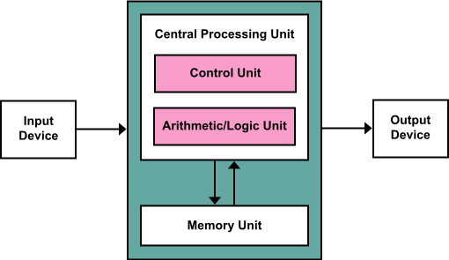
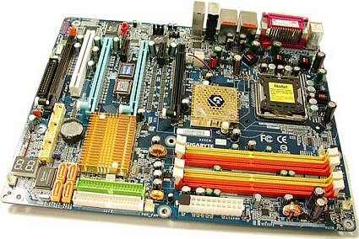
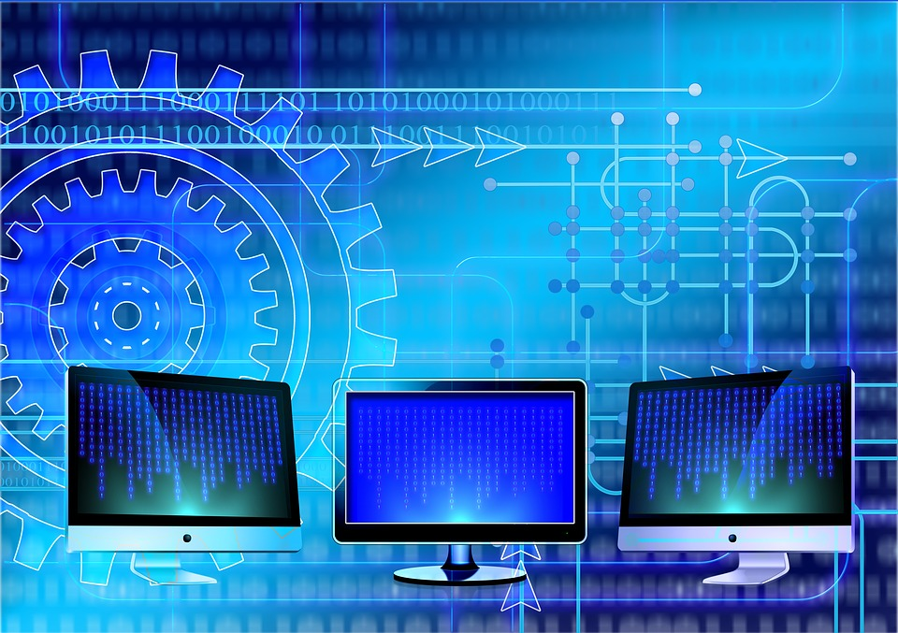
How actually computer work:
Input
Storage
Processing
Output
This Photo CC BY-SA-NC
This Photo by Unknown Author is licensed under CC BY-SA-NC

Slide 4

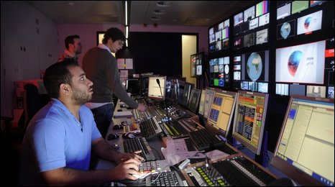
Ata
What is Multitasking!
Multitasking is a common feature of computer operating system since 1960s.
It is a concept of performing multiple task at the same time.
It is the process of running multiple programs simultaneously;
It allows more efficient use of the computer hardware;
This Photo by Unknown Author is licensed under CC BY-SA-NC

Slide 5

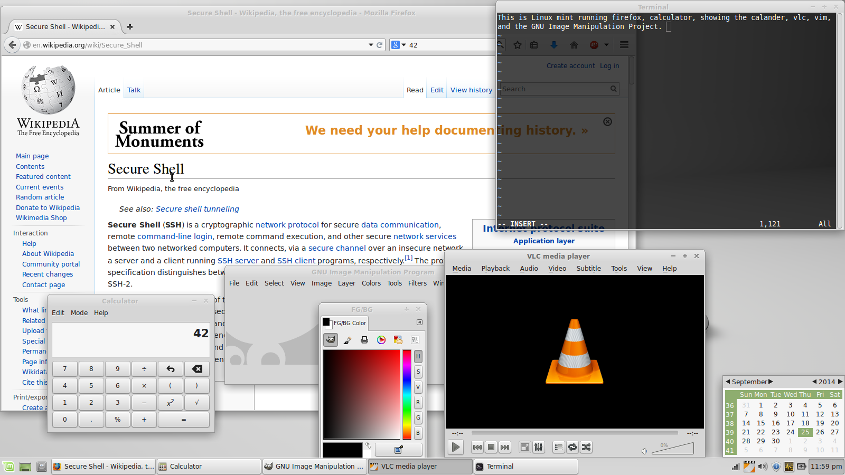
Ata
Where a program is waiting for some external event such as a user input or an output transfer with a peripheral to complete, the central processor can still be used with another program.
In a time sharing system, multiple human operators use the same processor as if it was dedicated to their use, while behind the scenes the computer is serving many users by multitasking their individual programs.

Slide 6
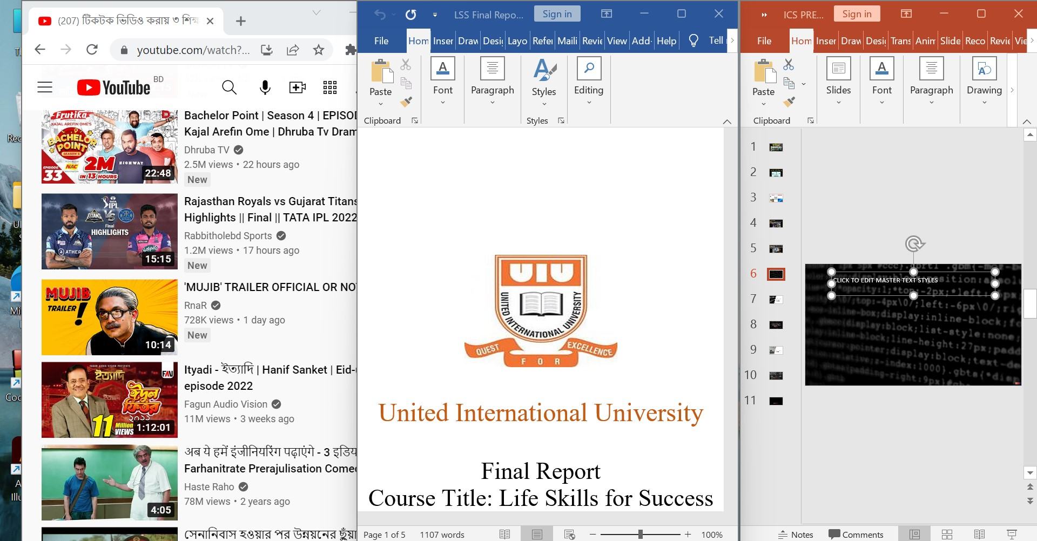
ATA
We can run multiple browser or apps simultaneously on a computer at the same time;
We give direction the operating system to run multitasking when we open word at the same time;

Slide 7
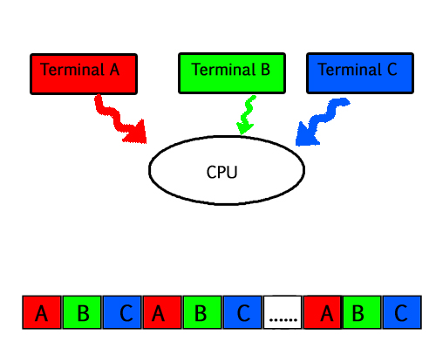
Terminal
Computer Multitasking allows multiple application to be simultaneously resident in memory;
This Photo by Unknown Author is licensed under CC BY-SA-NC
A single mouse click switches between applications, and information from one application can be copied to another.

Slide 8
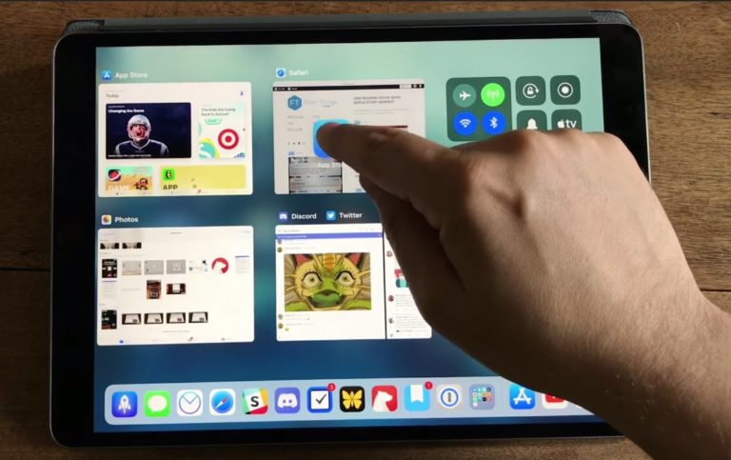
Advantage
Advantage of Multitasking:
The advantage of multitasking is the ability to have several applications open and working at the same time.
For example, a user can edit a file with one application while another application is recalculating a spreadsheet.
This Photo by Unknown Author is licensed under CC BY-NC

Slide 9
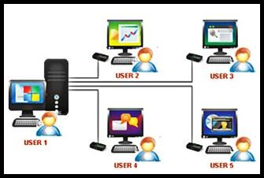
ASD
Time sharing is the another concept and benefit of Multitasking. All task are given a suitable amount of time and no waiting time occurs for the CPU.
This Photo by Unknown Author is licensed under CC BY-SA-NC
OS runs smoothly in using multitasking. All type of computer users becomes satisfied. Either user can run a single program or multiple program they don’t feel any fault in using a computer.

Slide 10

Dis
Disadvantage of Multitasking:
For a new user, multitasking would possibly give off a sense of confusion.
Due to several programs that the computer needs to process, there is a high tendency that computer performance would be affected. It might encounter buffering and processing speed may slow down.
This Photo by Unknown Author is licensed under CC BY-NC-ND

Slide 11
Thank You
PRESENTED BY
MD. AMMAR HOSSAIN
ID: 011221601
End

